Slide 1
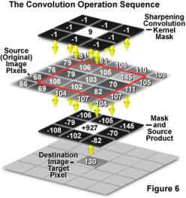
Basic operation (III)
Mingli Song
College of Computer Science, Zhejiang University
brooksong@zju.edu.cn
http://person.zju.edu.cn/msong

Slide 2
Geometric transform
1 Simple geometric transform
2 Interpolation
3 Warp and morph
4 Application

Slide 3
Concept of Image Morph
Morph is not warp (geometric transformation)
Morph is a kind of morphological changing, which makes an image change to another image gradually.
Morph handles both the location and the intensity of a pixel.
The beginning image and end image are two key frames. Other frames between the two key frames are generated automatically.
Notes:
这里讨论的Morph变形不同于一般的几何变换(Warp)。
Morph变形指景物的形体变化，它是使一幅图像逐步变化到另一幅图像的处理方法。
这是一种较复杂的二维图像处理，需要对各像素点的颜色、位置作变换。
变形的起始图像和结束图像分别为两幅关键帧，从起始形状变化到结束形状的关键在于自动地生成中间形状，也即自动生成中间帧。

Slide 4
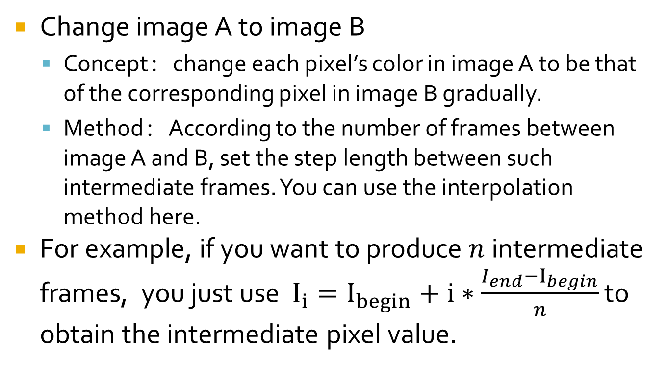
Morph
Notes:
大小相同的两幅图的转换作静态变换。从一幅图a逐渐变化成第二幅图b。
原理：让图a中每个像素的颜色，逐渐变成图b相同位置像素的颜色。
方法：根据变换的快慢，设置相应的步长，将图a每一点的RGB逐渐变成图b相同位置象素的RGB。可以选择等比或等差的方式，或其它方式让：rª-->r^{b}。
对于灰度图像，可以直接用等比或等差级数定义步长，使颜色从原图变到目标图。

Slide 5
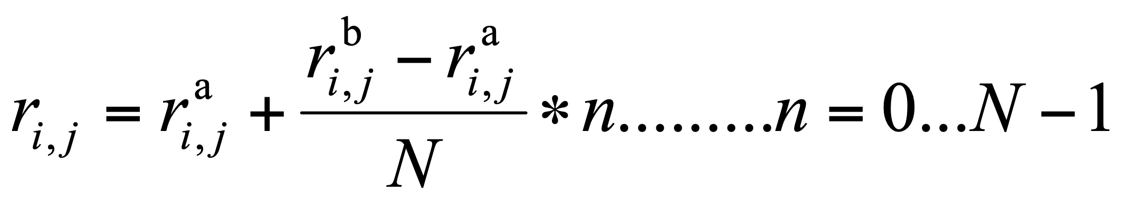
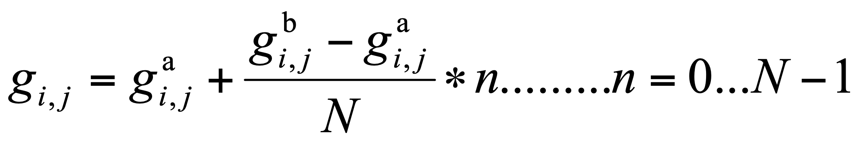
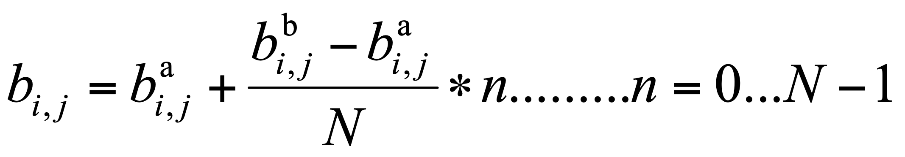
Morph
Given a color image, RGB should be taken into account together.
Notes:
对于彩色图像，RGB三色同时从原图变到目标图像。可以分别变化，也可考虑RGB的相对比例关系同时变化。

Slide 6
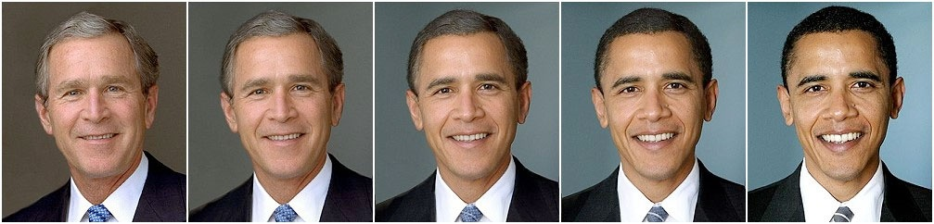
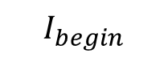

$$I_{begin}$$
$$I_{end}$$

Slide 7







Slide 8
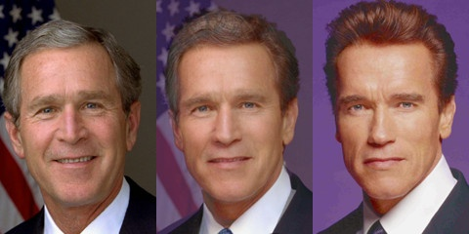
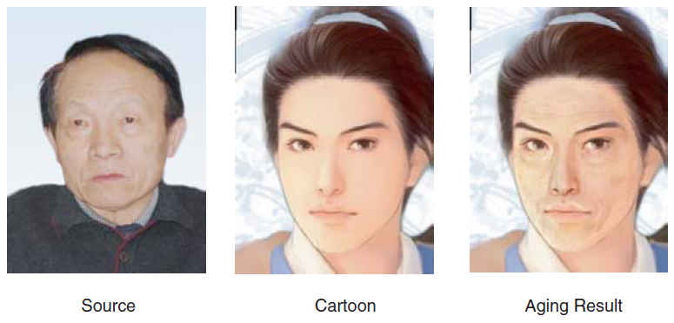
How to choose the key frames
The two key frames should be similar in structure and size, so as to obtain a natural and consistent morphing result.
Notes:
选择两幅结构相似、大小相同的画面作为起始和结束关键帧，这样才能比较容易地实现自然、连续的中间变形过程。

Slide 9
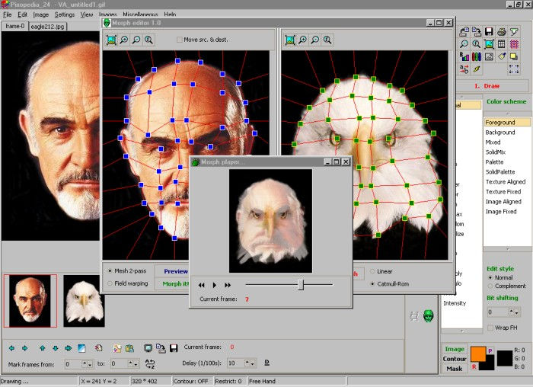
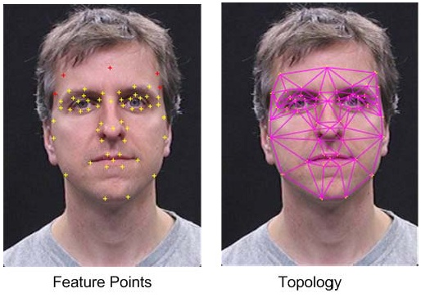
How to obtain the structure?
Label a series of feature points to define the structure of the beginning and end frame.
The feature points should keep correspondence.
Notes:
在起始和结束画面上确定和勾画出各部分（主要轮廓）的结构对应关系，也即从起始画面上的一个点变到结束画面上的另一个对应点的位置，这是变形运算所需要的参数。根据需要，对应点的位置可以任意移动。调整起始帧的对应点位置，可以模拟摄像中的镜头渐变效果。

Slide 10
Morph based on segment (two points)
After the feature points are determined, a series of segments are obtained.
If we want to morph segment A to be B, both the location and the color of each pixel in the image will change accordingly.
Notes:
在各点像素坐标变化的同时，每个像素的颜色RGB也一起从原图像改变为目标图像。

Slide 11
Different interpolation methods can be employed.
Notes:
这时可以采用不同的插值策略计算像素中间值（空间，颜色）

Slide 13

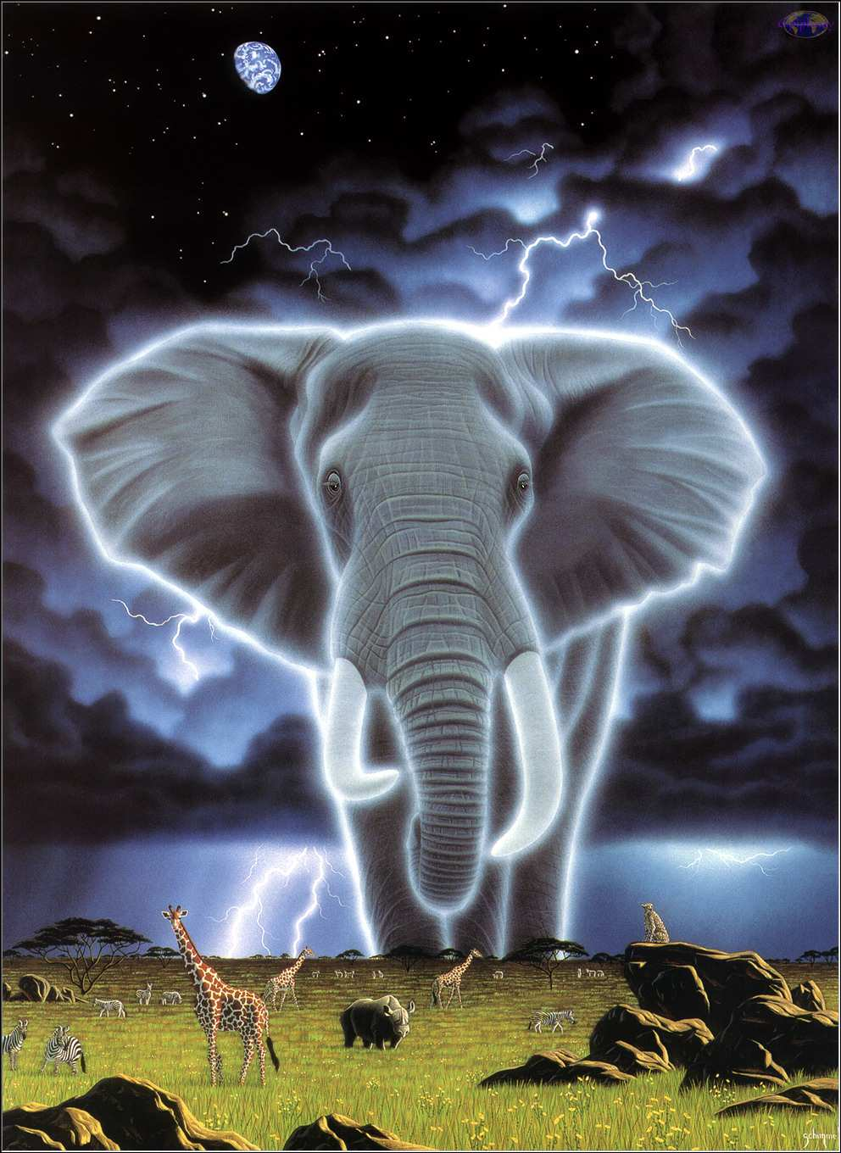
Example-morph based on feature points
Define the corresponding feature points between two images.
3
3
2
4
2
4
1
1
5
6
5
6

Slide 14
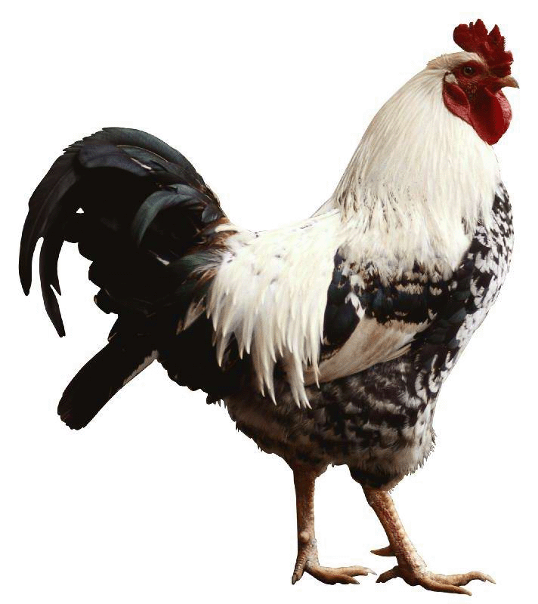
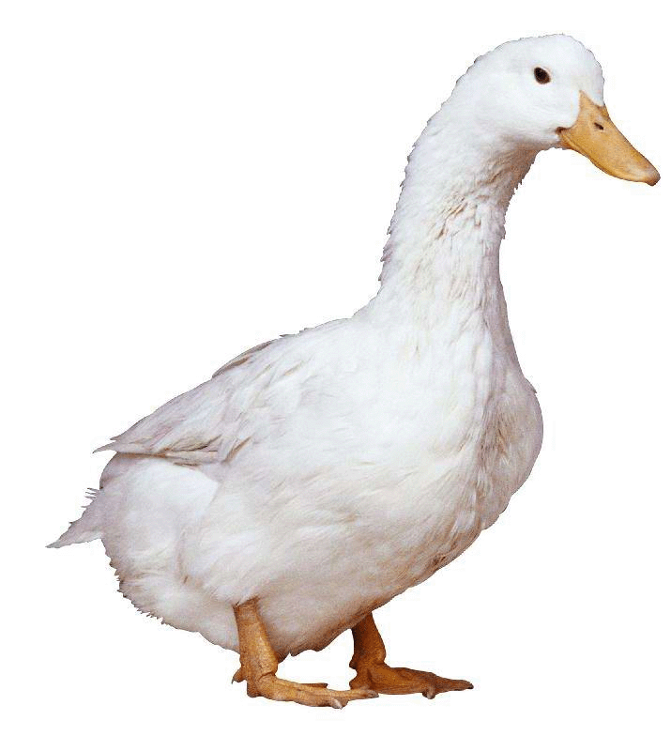
Example-morph based on grid
Define the correspondence between the two images by grid, the intermediate frames can be obtained by predefined interpolating function.
Notes:
确定坐标变换函数，根据变换函数产生中间帧。

Slide 15


Morph based on grid
Fish eye effect?
Notes:
视点变换就是求在视点移动后原始图像变换生成的新视图。
在用相机拍摄物体时，保持物体的位置不动，而将相机移离物体，这就相当于视点变换；
如果我们保持相机固定位置，将物体移离相机，这就相当于模型转换。
视点变形要求对物体有三维坐标知识。

Slide 16
Application
Expressive Expression Mapping with Ratio Images
ACM SIGGRPAH 2002

Slide 17
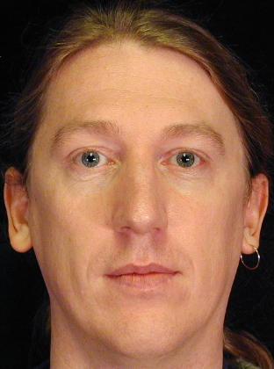

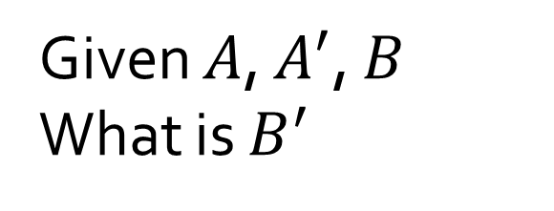

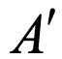
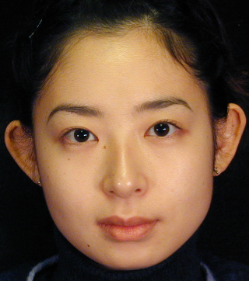


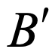
Problem

Slide 18
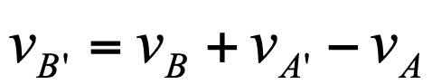

Possible Solution
Geometric warping:
Expression details lost

Slide 19
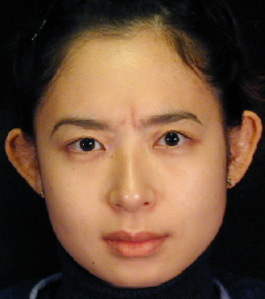
Our Solution
Add expression details
Our method

Slide 20
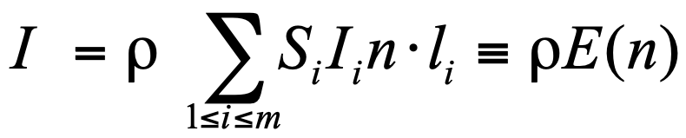
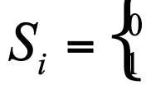
Lambertian model
Assume there are m point light sources:
where:
If the point cannot be seen from light i
Otherwise

Slide 21
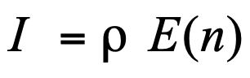
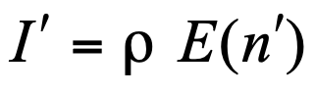
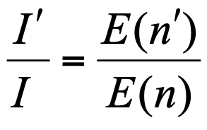
Expression ratio image
Before deformation:
After deformation:
Expression ratio image:
ERI:
captures illumination changes caused by surface deformation
is material independent

Slide 22
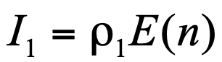
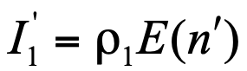
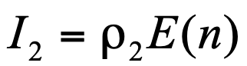
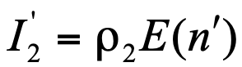
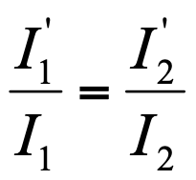
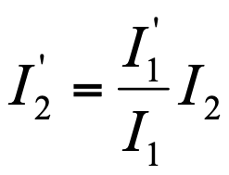
Surface deformation mapping
Two surfaces
same normals at the corresponding points
different materials
same deformations
Before deform.
After deform.
Surface 1:
Surface 2:

Slide 23
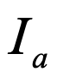
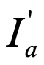
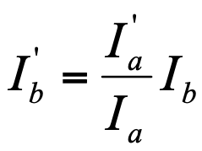
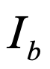
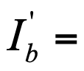
Expression mapping
Assumption:
Human faces have approximately the same normals
Neutral
Expression
Person A:
?
Person B:

Slide 24
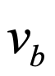
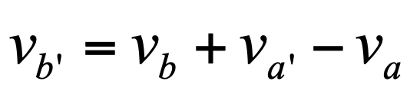
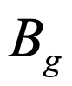
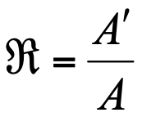
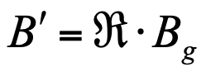
Algorithm
Input: Images
Step1: Mark feature points
Step2: For each feature point in , warp it:
Let be the warped image of B
Step3: Align , with by image warping.
Step4: Compute ratio image:
Step5:

Slide 25
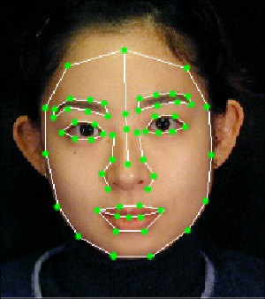
Image alignment
Manually mark face features
Use image warping to obtain pixel correspondence

Slide 26
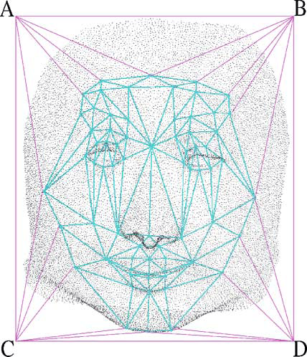
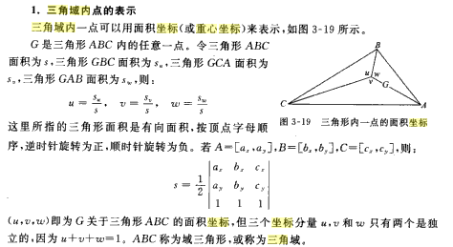
孙家广，胡事民，计算机图形学基础教程，清华大学出版社

Slide 27
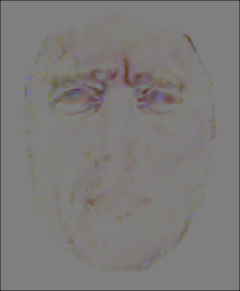
Results

Slide 28
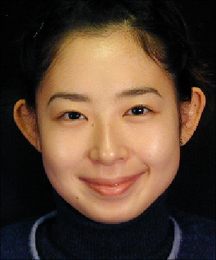
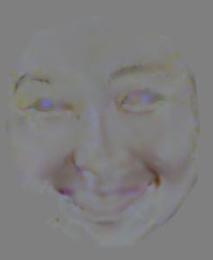
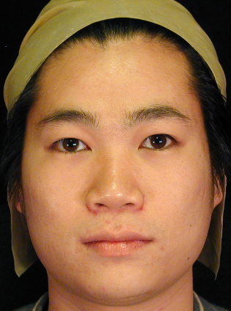
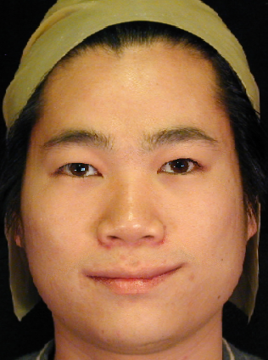


Slide 29






Slide 30





Slide 31







Slide 32







Slide 33
Conclusion
Generate photo-realistic expression details
Enhance existing expression-mapping techniques:
Difference vector + ERI = Convincing F.E.

Slide 34











Slide 35


Slide 36
Another funny stuff
A demo morph application.

Slide 37


Slide 38



Slide 39
Basic Image Operation (IV) 图像基本操作(IV)
Mingli Song
College of Computer Science, Zhejiang University
brooksong@zju.edu.cn
http://person.zju.edu.cn/msong/

Slide 40
1D convolution
1．Continuous 1D convolution
2．Properties of convolution
3．Discrete 1D convolution
4. Spatial domain filtering

Slide 41
1D Convolution
Continuous 1D convolution——Definition
The convolution $g(x)$ of two 1D functions $f(x)$ and $h(x$)
which means the convolution of two 1D functions can be formulated as an integral of multiplication.
Usually we call $f(x)$ as input function, $h(x)$ as convolution function.
Notes:
两个一维连续函数f(x)和h(x)的卷积g(x)为
它表示两个函数的卷积可以转化成乘积的积分来计算。通常将f(x)称为输入函数，将h(x)称为卷积函数。

Slide 42
1D convolution
Continuous 1D convolution——Computing process
Given two functions, how to compute their convolution result at an arbitrary point $x$
h(t)
f(t)
t
0
0
t
Input function
Convolution function
Notes:
已知两个函数，要求计算它们的卷积在任意点x处的值。

Slide 43
1D convolution
Continuous 1D convolution——Computing process
Step 1：flip the convolution function $h(t)$
h(t)
h(-t)
0
t
0
t
Convolution function $h(t)$
Flipped $h(t)$
Notes:
Step 1：将卷积函数h(t)反折

Slide 44
1D convolution
Continuous 1D convolution——Computing process
Step 2: translate the flipped $h(t)$ right with a distance $x$
h(-t)
h(x-t)
0
0
t
x
t
Flipped $h(t)$
Translate after flip
Notes:
步骤2：将反折后的卷积函数向右移动距离x

Slide 45
1D convolution
Continuous 1D convolution——Computing process
Step 3: Obtain the multiplication results of $f$ and $h$ at any $t$, and calculate their integral.
f(t)
h(x-t)
0
x
t
0
x
t

Slide 46
1D convolution
Continuous 1D convolution——Computing process
Repeat such computing process for each $x$, you will get an output curve $g(x)$.
When $x$ changes, the flipped function $h(x−t)$ go through the input function $f(t)$, $g(x)$ depends on the integral of the overlap section of these two functions.
f(t)
h(x-t)
0
x
t
Notes:
对每一个x值重复上述计算过程，就得到了输出曲线g(x)。
当x变化时，反折的函数被平移通过静止不动的输入函数，g(x)值取决于这两个函数的重叠部分的累积。

Slide 47
1D convolution
Continuous 1D convolution——Computing process
Repeat such computing process for each $x$, you will get an output curve $g(x)$.
When $x$ changes, the flipped function $h(x−t)$ go through the input function $f(t)$, $g(x)$ depends on the integral of the overlap section of these two functions.
f(t)
h(x-t)
0
x
t
Notes:
对每一个x值重复上述计算过程，就得到了输出曲线g(x)。
当x变化时，反折的函数被平移通过静止不动的输入函数，g(x)值取决于这两个函数的重叠部分的累积。

Slide 48
1D convolution
Continuous 1D convolution——Computing process
Repeat such computing process for each $x$, you will get an output curve $g(x)$.
When $x$ changes, the flipped function $h(x−t)$ go through the input function $f(t)$, $g(x)$ depends on the integral of the overlap section of these two functions.
f(t)
h(x-t)
0
x
t
Notes:
对每一个x值重复上述计算过程，就得到了输出曲线g(x)。
当x变化时，反折的函数被平移通过静止不动的输入函数，g(x)值取决于这两个函数的重叠部分的累积。

Slide 49
1D convolution
Continuous 1D convolution——Computing process
Repeat such computing process for each $x$, you will get an output curve $g(x)$.
When $x$ changes, the flipped function $h(x−t)$ go through the input function $f(t)$, $g(x)$ depends on the integral of the overlap section of these two functions.
f(t)
h(x-t)
0
x
t
Notes:
对每一个x值重复上述计算过程，就得到了输出曲线g(x)。
当x变化时，反折的函数被平移通过静止不动的输入函数，g(x)值取决于这两个函数的重叠部分的累积。

Slide 50
1D convolution
Continuous 1D convolution——Computing process
Repeat such computing process for each $x$, you will get an output curve $g(x)$.
When $x$ changes, the flipped function $h(x−t)$ go through the input function $f(t)$, $g(x)$ depends on the integral of the overlap section of these two functions.
f(t)
h(x-t)
0
x
t
Notes:
对每一个x值重复上述计算过程，就得到了输出曲线g(x)。
当x变化时，反折的函数被平移通过静止不动的输入函数，g(x)值取决于这两个函数的重叠部分的累积。

Slide 51
1D convolution
Continuous 1D convolution——Computing process
Repeat such computing process for each $x$, you will get an output curve $g(x)$.
When $x$ changes, the flipped function $h(x−t)$ go through the input function $f(t)$, $g(x)$ depends on the integral of the overlap section of these two functions.
f(t)
h(x-t)
0
x
t
Notes:
对每一个x值重复上述计算过程，就得到了输出曲线g(x)。
当x变化时，反折的函数被平移通过静止不动的输入函数，g(x)值取决于这两个函数的重叠部分的累积。

Slide 52
1D convolution
Property of convolution——Exchangeable
Notes:
交换性
含义：将任一函数反折，都会得到相同的结果。

Slide 53
1D convolution
Proof
Let
We have

Slide 54
1D convolution
Property of convolution——Distributive

Slide 55
1D convolution
Proof

Slide 56
1D convolution
Property of convolution——Associative
Notes:
结合律

Slide 57
1D convolution
Discrete 1D convolution——
For a discrete sequence, the integral can be treated as summing up problem.
For $f(x)$ and $h(x)$ whose lengths are $M$, their convolution is：
Notes:
对于离散序列，其卷积可用与连续函数相类似的方法求得。此时自变量变为下标，面积则由求和代替。
对于两个长度均为M的序列f(x)和h(x)，其卷积为：

Slide 58
1D convolution
Example
f(t)
Both $f(x)$and $h(x)$ have 400 samples, i.e., $x=0,1,2,…,399$.
3
Input function
t
$$f\left(x\right)=\left\{\begin{matrix}3 & 0≤x<300 \\ 0 & 300≤x<400\end{matrix}\right.$$
0
200
400
h$\left(x\right)=\left\{\begin{matrix}2 & 0≤x<200 \\ 0 & 200≤x<400\end{matrix}\right.$
h(t)
Convolution function
2
compute $g(x)$ at each $x$
t
0
200
400
Notes:
输入函数f(x)和卷积函数h(x)均含有400个样本点，即x=0,1,2,…,399。两个函数的定义分别如下：

Slide 59
1D convolution
h(t)
Step 1:
Flip $h\left(t\right)$ to be $h(−t)$
2
t
0
200
400
2
h(-t)
Flipped $h(t)$
t
0
200
400
Notes:
步骤1：
将卷积函数h(t)关于原点进行镜像映射（倒转），得到h(-t)。

Slide 60
1D convolution
2
Step 2：
Slide $h(−t)$ by adding $x$, i.e., h(x-t)。
h(-t)
t
0
200
2
Sliding $h(−t)$
h(x-t)
t
0
200
x
Notes:
步骤2：
将倒转过的函数h(-t)滑过f(t)，这要增加一个常数位移x到h(-t)，即变成h(x-t)。

Slide 61
1D convolution
Step 3：
For each sample $t （t = 0, 1, 2, 3, …, 399）$, compute $f\left(t\right)h\left(x−t\right);$
Sum up all the $f\left(t\right)h(x−t)$ and divide it by $M (M=400)$ .
Now you get the convolution at $x$.
Step 4：
Compute the convolution value for each $x$ in the “effective range”.
You get a curve of $g\left(x\right).$
f(x)*h(x)
3
1.5
x
0
200
400
600
800
Notes:
步骤3：
对每一个样本点t （t = 0, 1, 2, 3, …, 399）都计算乘积f(t)h(x-t)，然后将这些乘积相加后除以常数M（=400），就得到在位移x下的卷积。
步骤4：
对有效范围内的所有位移x均计算一个卷积，这样，所有这些值就形成了一条曲线。

Slide 62
1D convolution
f(t)
3
t
0
200
400
400
600
800
Effective range：
Covers all the points that $h(t)$ go through during the sliding operation.
In this example, the effective range of $x$ is from 0 to 799.

Slide 63
1D convolution
f(x)*g(x)
3
1.5
x
0
200
400
600
800
Hence the convolution $g(x)$ is also a function and its variable is $x$.
Notes:
两个函数的卷积也是一个函数，变量是x。

Slide 64

Example of 3x3 convolution mask
[Jain, Kasturi, and Schunck (1995). Machine Vision, Ch. 4]

Slide 65
Example of 3x3 convolution mask
[Jain, Kasturi, and Schunck (1995). Machine Vision, Ch. 4]

Slide 66
In plain words
Convolution is essentially equivalent to computing a weighted sum of image pixels.

Slide 67
Assignments
Image mean filtering
Laplacian image enhancement

Slide 68
Spatial filtering
Principle of filtering——Concept
Concept: Filter is a window sized by M×N, wherein the elements in the window take operation on the corresponding pixels from the original image in the window. And the results are saved as the pixels in a new image.
Alias: Filter, mask, kernel, template, window
The elements in the filter are coefficients instead of pixel values, which represent the weight applied on the pixels in the original image.
Notes:
滤波器是一个大小为M×N的窗口，窗口中的元素与原图像的处于窗口内的像素进行某种运算，结果作为新图像的一个像素。当窗口滑过原图像并完成上述运算之后，就能够得到一幅新图像。
滤波器的别名：滤波器、掩模、核、模板，窗口
滤波器子图像中的值是系数值，而不是像素值，它代表了影响新像素产生的权重。

Slide 69
Spatial filtering
Principle of filtering——Procedure
Image origin
y
Mask
For each pixel $(x,y)$ in the image, its response value to the filter is computed in terms of the predefined relationship between the elements in the filter.
Image f(x,y)
w(-1,-1)
w(-1,0)
w(-1,1)
w(0,-1)
w(0,0)
w(0,1)
x
w(1,-1)
w(1,0)
w(1,1)
For spatial linear filtering, the response value is computed by summing up the multiplication between the coefficient and its corresponding pixel.
f(x-1,y-1)
f(x-1,y)
f(x-1,y+1)
coefficients
f(x,y-1)
f(x,y)
f(x,y+1)
f(x+1,y-1)
f(x+1,y)
f(x+1,y+1)
The corresponding pixels
Notes:
在待处理图像中逐点移动掩模，在每一点(x,y)处，滤波器在该点的响应通过实现定义的关系来计算。对于线性空间滤波，其响应由滤波器系数与滤波掩模扫过区域的对应像素值的乘积之和给出。

Slide 70
Spatial filtering
Principle of filtering——Response
w(-1,-1)
w(-1,0)
w(-1,1)
w(0,-1)
w(0,0)
w(0,1)
w(1,-1)
w(1,0)
w(1,1)
f(x-1,y-1)
f(x-1,y)
f(x-1,y+1)
Coefficients
f(x,y-1)
f(x,y)
f(x,y+1)
f(x+1,y-1)
f(x+1,y)
f(x+1,y+1)
The corresponding pixels
Convolution：
Notes:
相当于以x为中心求和

Slide 71
Spatial filtering
Principle of filtering——Response
Usually, the width and the height of the mask are odd number such as 2a+1 and 2b+1. When the mask window is centered at (x,y), the updated value of (x,y) is computed as:
After updating all the pixels in the image, you will obtain a new image g.
Notes:
通常，掩模的长宽都为奇数。假设分别为2a+1和2b+1。当窗口中心处于像素(x,y)处时，新的像素值为：
对图像f中所有像素都与掩模进行运算之后，最终产生一幅新图像g。

Slide 72
Spatial filtering
Principle of filtering——Response
Simplified form:
After updating all the pixels in the image, you will obtain a new image g.

Slide 73

Spatial filtering
Spatial filtering for smoothing
When you find there are too many artifacts or noises in the image, you can carry out smoothing operation on the image to suppress the noise and reduce the artifacts. However, the smoothing operation will make the image blurring.
Image after low-pass filtering
Notes:
图像在传输过程中，由于传输信道、采样系统质量较差，或受各种干扰的影响，而造成图像毛糙，此时，就需对图像进行平滑处理。平滑可以抑制高频成分，但也使图像变得模糊。

Slide 74
Spatial filtering
Spatial filtering--smoothing
Smoothing can reduce noises and blurring, which can be used in preprocessing. For instance, remove the subtle details when you just want to extract the big target.
Image after low-pass filtering
Notes:
平滑空间滤波器用于模糊处理和减少噪声。模糊处理经常用于预处理，例如，在提取大的目标之前去除图像中一些琐碎的细节，桥接直线或曲线的缝隙。

Slide 75
Spatial filtering
Spatial filtering--smoothing
Linear smoothing filter
Statistical sorting filter
Image after low-pass filtering

Slide 76
Spatial filtering
Linear smoothing filter——Concept
1
1
1
The output of the linear smoothing filter is the mean value of the pixels in the mask. It’s also called mean filter.
1
1
1
1
1
1
Notes:
平滑线性空间滤波器的输出是包含在滤波掩模邻域内像素的简单平均值。因此，这些滤波器也称为均值滤波器。

Slide 77
Spatial filtering
Linear smoothing filter——application
1
1
1
Mean filter is mainly used for subtle detail removal, namely, eliminating the unwanted region smaller than the mask.
1
1
1
1
1
1
Notes:
均值滤波器的主要应用是去除图像中的不相干细节，即那些与滤波掩模尺寸相比更小的像素区域。

Slide 78
Spatial filtering
Linear smoothing filter——example
1
1
1
Simple mean, pixels in the mask window contribute equally to the final result.
1
1
1
1
1
1
Weighted mean, pixels in the mask window contribute unequally to the final result.
1
2
1
2
4
2
Two 3×3 mean filter, each filter’s factor equals to the sum of all the coefficients in order to obtain the mean value.
1
2
1
Notes:
简单平均，表示窗口中每一个像素对响应的贡献是一样的
加权平均，表示窗口中的像素对相应的贡献有大小之分。
两个3×3平滑（均值）滤波器掩模，每个掩模前边的乘数等于它的系数值的和，以计算平均值

Slide 79
Spatial filtering
Linear smoothing filter——general equation
where the size of the filter is (2a+1) ×(2b+1), w is the filter, f is the input image, g is the output image.
Notes:
其中，滤波器大小为(2a+1) ×(2b+1)，w为滤波器，f为输入图像，g为输出图像。

Slide 80
Spatial filtering
Linear smoothing filter——Explanation
The size of the mask is very important for the final result. When the mask is small, the blurring effect is very subtle, and vice versa.
Notes:
滤波掩模的大小与图像的平滑效果有直接的关系。当掩模比较小时，可以观察到在整幅图像中有轻微的模糊，当掩模大小增加，模糊程度也随之增加。

Slide 81
Spatial filtering
Linear smoothing filter——application
In order to obtain a brief description of the object of interest, linear smoothing filter is used to blur the image to remove the smaller object while keeping the larger object.
Hence, the size of the mask depends on the object to be merged into the background.
Notes:
为了对感兴趣物体得到一个粗略的描述而模糊一幅图像，这样，那些较小物体的强度与背景混合在一起了，较大物体变得像“斑点”而易于检测。掩模的大小由那些即将融入背景中去的物件尺寸来决定。

Slide 82

Spatial filtering
Linear smoothing filter——application

Slide 83
Spatial filtering
Statistical sorting filter——Concept
Statistical filter is a kind of nonlinear spatial filter, whose response is based on the sorting of pixel value in the mask window. The value of center pixel depends on the sorting result in the window.
The most popular statistical filter is median filter.
Notes:
统计滤波器是一种非线性的空间滤波器，它的响应是基于窗口内图像区域中像素值的排序，由统计排序结果决定的值代替中心像素的值。
统计滤波器中最常见的例子就是中值滤波器。

Slide 84
Spatial filtering
Statistical sorting filter——Median filter
Substitute the center pixel with the median value in the neighborhood.
Provide excellent de-noise ability, which introduce less blurring than the mean filter.
Be effective to deal with the pulse noise (or pepper noise) because this kind of noise looks like bright or dark point in the image.
Notes:
用像素邻域内灰度的中值代替该像素的值。
提供了优秀的去噪能力，比小尺寸的线性平滑滤波器的模糊程度明显要低。
对处理脉冲噪声（也称为椒盐噪声）非常有效，因为这种噪声是以黑白点叠加在图像上的。

Slide 85
Spatial filtering
Statistical sorting filter——median filter
The median value ξ——in a set of numbers, About half of them are smaller than ξ，others larger than ξ.
In order to perform median filtering on a pixel in the image, pixel sorting should be carried out in the mask window to select the median value and change the pixel value to the median value.
Notes:
中值ξ——数值集合中，有一半数值小于或等于ξ，还有一半大于或等于ξ。
为了对一幅图像上的某个点作中值滤波处理。必须先将掩模内欲求的像素及其邻域的像素值排序，确定出中值，并将中值赋予该像素点。

Slide 86

Spatial filtering
Statistical sorting filter——media filter, example
In a 3×3 neighborhood, there are a series pixel values：
（21，100，99，22，20，102，97，101）
After sorting：
（20，21，22，97，100，101，012）
Median value：97
Notes:
在一个3×3的邻域内有一系列像素值：
（21，100，99，22，20，102，97，101）
对这些值排序后为：
（20，21，22，97，100，101，012）
中值：97

Slide 87
Spatial filtering
Statistical sorting filter——median filter
Usually we use n×n median filter to remove the unwanted brighter or darker pixels in the neighborhood, and their area is less than n²/2（half of the mask window）.
Notes:
常用n×n的中值滤波器去除那些相对于其邻域像素更亮或更暗，并且其区域小于n²/2（滤波器区域的一半）的孤立像素集。

Slide 88
Spatial filtering
Sharpening spatial filter——Purpose
Enhance the detail or sharpen the blurred part in the image
Notes:
突出图像中的细节或者增强被模糊了的细节。

Slide 89
Spatial filtering
Sharpening spatial filter——Tool
Differential operator is a sharpening tool, whose response depends on the variation between neighboring pixel values.
Differential Operator strengthens the edges and other obvious variations (including noise) in the image, and weakens the slight changes.
Notes:
微分算子是实现锐化的工具，其响应程度与图像在该点处的突变程度有关。微分算子增强了边缘和其他突变（如噪声）并削弱了灰度变化缓慢的区域。

Slide 90
Spatial filtering
Sharpening operator
Concept of differential operator
Second order differential based image enhancement——Laplacian operator
First order differential based image enhancement——gradient based method
Notes:
基于二阶微分的图像增强——拉普拉斯算子
基于一阶微分的图像增强——梯度法

Slide 91
Spatial filtering
Differential——
For a function f(x)，we use difference to represent the differential operator:
Similarly, the second order differential is：
Notes:
对于函数f(x)，用差值来表达一阶微分：

Slide 92

Spatial filtering
Differential——Example
A simple image, composed by solid object, line segment and single noisy pixel.
Profile of the image along with the central line, which includes a noisy pixel.
Simplified profile.by dot-line.
Notes:
(a) 一幅简单图像，包含各种实心物体、一条线及一个单一噪声点。 (b) 沿图像中心并且包含一个噪声点的一维水平灰度剖面图。(c) 简化的剖面图（用虚线连接点以简化描述）

Slide 93
Spatial filtering
Image enhancement based on first order differential operator——gradient based method
For a function f(x,y)，we first define a 2-D vector：
How to compute gradient?
Its magnitude is computed as:
Notes:
对于函数f(x,y)，首先定义一个二维列向量：

Slide 94
Spatial filtering
Image enhancement based on first order differential operator——gradient based operator
It’s time consuming to compute the gradients for all the pixels in the image. Hence, absolute value is usually used to replace the original gradient magnitude.
Notes:
当对整幅图像计算梯度时，运算量会很大，因此，在实际操作中，常用绝对值代替平方与平方根运算近似求梯度的模值：

Slide 95
Spatial filtering
Gradient based method——Another approach
z₁
z₂
z₃
-1
0
0
-1
z₄
z₅
z₆
0
1
1
0
z₇
z₈
z₉
Robert cross gradient operator, Gx=(z9-z5)
Gy=(z8-z6)
Original image, z_{i} is the pixel value, z₅ is the center pixel.
Or
Notes:
z_{i}为像素值，z₅为当前像素
Robert 交叉梯度算子，左上角对应当前像素。它们采用了如下交叉差分算法：Gx=(z9-z5)和Gy=(z8-z6)。梯度算法：

Slide 96
Spatial filtering
Image enhancement based on second order differential——Laplacian operator
For a function f(x,y), Laplacian operator is defined as:

Slide 97
Spatial filtering
The discrete Laplacian operator:
Along x axis:
Along y axis:
Hence, the discrete Laplacian operator is:
Notes:
在x方向上对二阶偏微分采用下列定义：

Slide 98
Spatial operator
Mask of Laplacian operator
0
1
0
1
-4
1
0
1
0
It is rotation invariant.
Notes:
各向同性，旋转不变。

Slide 99
Spatial filtering
Extending the mask
The elements in the diagonal direction can also be taken into account：
Or
Notes:
对角线上的元素也可以考虑进来设计掩膜

Slide 100
Spatial filtering
Extended mask
1
1
1
1
-8
1
1
1
1
It’s also rotation invariant, i.e., isotropic.

Slide 101
Spatial filtering
Extended mask
0
-1
0
-1
-1
-1
-1
4
-1
-1
8
-1
0
-1
0
-1
-1
-1
When you fuse the Laplacian result and the original image together, you have to consider the symbol difference between them.
Notes:
当拉普拉斯滤波后的图像与其它图像合并时（相加或相减），则必须考虑符号上的差别。

Slide 102
Spatial filtering
Application of Laplacian operator
Image enhancement by Laplaician:
If the center element of the mask is negative
If the center element of the mask is positive
Fuse the original image and the Laplacian result can preserve the sharpening effect and restore the original visual information.
Notes:
将原始图像和拉普拉斯图像叠加在一起的简单方法可以保护拉普拉斯锐化处理的效果，同时又能复原背景信息。

Slide 103




Spatial filtering
Laplacian Example
(a)Original image (b)Laplacian result ( c)Rearranged Laplacian result (d) After fusion

Slide 104
Spatial filtering
Laplacian: example
1
1
1
1
-8
1
1
1
1
(a) Original image
(b) Laplacian result

Slide 105
Spatial filtering
Laplacian: example
Rearrange the Laplacian result in terms of enhancing level
(b) Laplacian result
(c) Rearranged Laplacian result

Slide 106
Spatial filtering
Laplacian-example
Fuse
(a) Original image
(d) After fusion

Slide 107
Bilateral filtering
Gaussian smoothing
Bilateral filtering
Input

